Slide 1



Train for trainers – open source in the cloud / Warsaw, 2013 /
#ms_oss
Kick-off – who we are, why we are doing this and what we expect from this event
@azure_cee

Slide 2
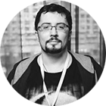
Alexander Belotserkovsky
Windows Azure Expert
Email : v-albelo@microsoft.com Skype : n-alebelo Twitter: @ahriman_ru
Bio: Alex is a cloud specialist, works as a Nurturer for Russian and CIS Windows Azure customers. Alex is actively engaged in speaking activities as TechEd, DevCon, Windows Camp. Provides customers with professional technical and technological support for their cloud projects such as migration, development, deployment, architecture. Actively collaborates with IT Pro and Dev Pro community around the world driving cloud efforts. Active blogger (http://hpcru.wordpress.com). In past was engaged in High Performance Computing field.

Slide 3
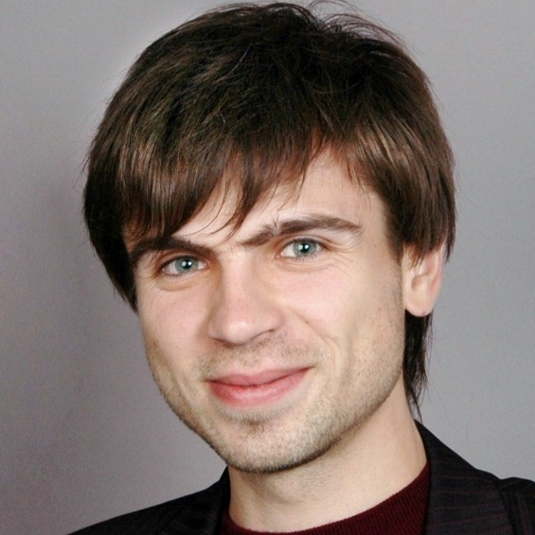
Kostyantyn Khrushchelov
Open Source Strategy Consultant
Email : v-kokhru@microsoft.com Skype : kostyakhr Twitter: @kostyakhr
Bio: Kostyantyn Khrushchelov is an independent consultant, currently working for Microsoft as Open Source Strategy Consultant for Ukraine and also to run a project OSS on Azure in CEE. Before that he was working in Microsoft Ukraine as Server & Tools Business group lead and large Ukrainian system integrator with more than 12 year experience in IT. He’s in charge of marketing activities for Microsoft Central and Eastern Europe to demonstrate Microsoft Openness strategy, establish cooperation with Open Source communities and developers and promote Windows Azure to Open Source audiences.

Slide 4
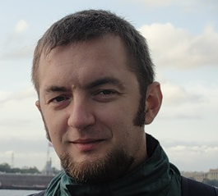
Alexey Bokov
Windows Azure Evangelist for CEE
Email : abokov@microsoft.com Skype : alexey_bokov Twitter: @abokov
Bio: Alexey Bokov is cloud computing expert, works as Windows Azure evangelist for CEE in Microsoft. He's actively communicate with partners and IT community, frequently speak on cloud computing events as well as work with startups as technology mentor. In past he has more than 10 years in R&D - from junior engineer and up to development manager, great experience with online technologies and building 24x7 scalable apps. Currently Alexey is driving Windows Azure cloud in Russia and CEE countries as evangelist covering both technical and business topics of cloud applications. Alexey is actively collaborate with IT pro and business evangelists community driving cloud technologies and he's member of Russian Cloud Computing Association.

Slide 5

Why we are doing this :
Where Microsoft is today:
Microsoft changed strategy and is much more open to open source than 2 year ago but very few know that.
Microsoft is moving away from software company to Devices and Services company.
Microsoft is developing its services with Open Source world in mind as a first class citizen.
Now what:
Windows Azure is a new great technology and it is not on .NET only. The biggest barrier for open source world is historical negative perception.
Why we are here:
We are here to establish and support independent community of OSS influencers who are pragmatic and wish to be on the forefront of the cloud.
The goal is to share technical knowledge about Windows Azure with the rest of OSS developers’ world.
The tricky thing is that Azure is not similar to other clouds and deep dive knowledge sharing is needed.

Slide 6
Community experts gives and gets:
You get:
Free deep-dive windows Azure technical trainings (1st event in November, Warsaw)
Recognition and awards (like TechEd conference tickets, valuable prizes for the best and most active experts, etc) for the most active experts in CEE
Direct contacts in Windows Azure R&D team in US and Europe
Free Azure ☺ - MSDN Ultimate subscription and access to Azure for 1 year
You may get Windows Azure MVP (Most Valuable Professional) status for the most active community leaders.
You gives ( our expectations☺ ) :
Tell others about it - write technical articles about Windows Azure and open source stories
Help others to use it -act as a trainer at hands-on workshops organized by Microsoft
Collaborate with Microsoft – stay in touch with local Microsoft teams in your countries and participate in event driven by global Microsoft
Be active member of community – post online, discuss things, answer questions and provide us feedback from your partners/customers

Slide 7
Goals
Improve collaboration with open source community
Tell influencers open source story – technologies and business side
Hands-on experience with open source in Azure
Open source workshops with best technology experts from Microsoft and community
Start our Facebook group!
Create useful artefacts in github
Stay tuned after event!

Slide 8







Online resources
msopentech.com
Open technologies in CEE
opennessatcee.com
CEE Azure user group in Facebook
facebook.com/groups/azurecee
Last new in our twitter
@azure_cee
Open technologies in CEE
@OpennessAtCEE
All questions about Azure in CEE
azure_cee@microsoft.com

